Slide 1

MECHANICAL ENGINEERING
The 2nd of the 5 main Branches.
By: Shannon Wilson & James Zartman
Notes:
NOTE:
To change the image on this slide, select the picture and delete it. Then click the Pictures icon in the placeholder to insert your own image.

Slide 2
Salaries for Mechanical Engineering
The salary range is fairly large!
Location can and does play a big part in what your wages will be.
The type of mechanical engineer sub-catigories will also make a difference in what your pay will be.
Yearly wages as Mechanical Engineer overall | lower average pay | Median average pay | Upper average pay
US averages (according to the Bureau of labor statistics) | $53,640 | $83,590 | $128,430

Slide 3
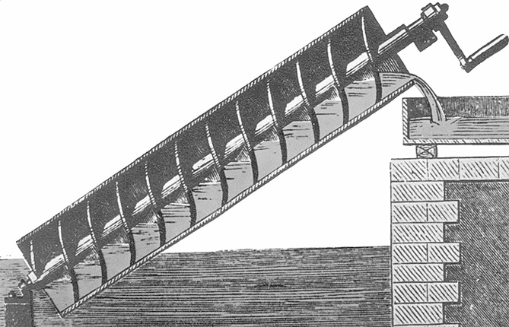
Early Contributions
Dates back to ancient times when humans invented the pulley, lever, and wheel for transportation and building needs.
287 B.C.E – 212 B.C.E-Inventions of Archimedes
  Archimedes screw was said to lift water from a lower level to a higher level which could be used to empty water out of ships or for irrigation purposes.
1174-1200- Al Jazari- made 5 machines to pump water to the palaces of Turkish kings
  First machine to use connecting rod and crankshaft which converted rotational motion to reciprocating motion
  Also made segmental gears, clocks, and protocols for designing and manufacturing methods.

Slide 4
What are the expected needs
In 2014 the estimated amount of engineering jobs were at 277,500.
Looking just 7 years from today to 2024, it is estimated that there will be 292,100 jobs available. A growth of about 5%.
With the broad area this branch covers Mechanical Engineering branches off in many directions of its own.
With things like nanotechnology, and remanufacturing and many other newly developing technologies the needs for Mechanical engineers can only grow!
Just a few different subcategories that could fall
under Mechanical Engineering.
Architectural and Engineering Managers
Materials Engineers
Mechanical Engineering Technicians
Nuclear Engineers
Petroleum Engineers

Slide 5
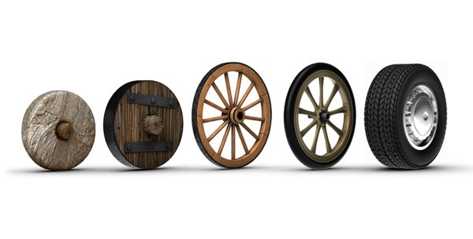
Major Inventions
Steam engine
  Made by James Watt in 1775 from improvements of the Newcomen engine
  This lead to the invention of the internal combustion engine
  Plays a huge role into todays society with inventions of machinery, automobiles, and airplanes
Wheel
  Made in ancient times and has posed to be a very useful tool throughout history.
  It is used in many applications- transportation, and farming.
  Has been said to be one of the greatest inventions of all time.

Slide 6
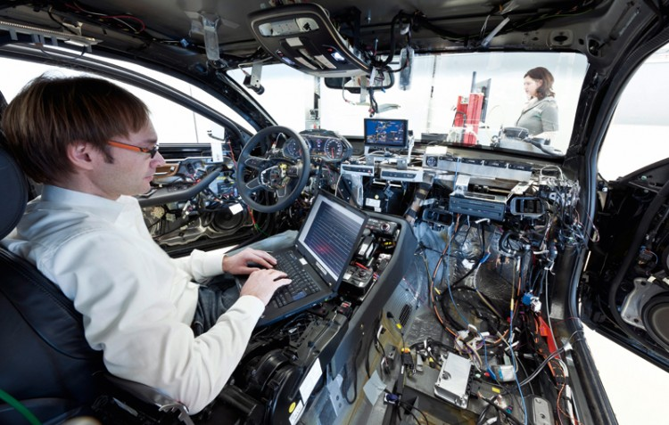
A Day in the life of a Mechanical Engineer.
This would depend on what job you are doing, it also depends on how long you have worked in the position.
In the first few years you may be working on production equipment, or making design drawings.
With a few years of experience you might be doing proposals for larger projects, and equipment upgrades. So you could possibly look at some new challenges each day!

Slide 7
Educational Requirements
Intermediate and Advanced Math classes
Life and Physical Sciences
Engineering and Design
The average cost for a Bachelors of Science degree in Mechanical Engineering from IPFW is $18750

Slide 8
What’s to come? The Future of Mechanical Engineering.
What is it?
Possible designs
Nanotechnology
Biotechnology
Help to design and make smaller microchips which can lead to newer and better equipment. Which will call for new ways to trouble shoot.
With newer, and progressing technologies come designing possibilities, like functioning body parts and the need for design and function.
As technology progresses, the needs for trouble shooting, new designs, and new ways to use the technology.

Slide 9
All web sites and locations used as reference for this project.
www.plancess.com/jee-mag/mechanical-engineering-career-scope-growth-prospects/ (pic slide 1)
http://www.payscale.com (salary)
www.bls.gov/oes/current/oes172141.htm (salary)
https://collegegrad.com/careers/mechanical-engineers (expected needs)
http://www.careercornerstone.org/mecheng/medaylife.htm (a day in the life)
www.quora.com/What-happens-in-a-day-of-the-life-of-a-mechanical-engineer (a day in the life)
http://www.worldwidelearn.com/online-education-guide/engineering/mechanical-engineering-major.htm (future things to design)
http://mechanicaldesign.asmedigitalcollection.asme.org/article.aspx?articleid=1472451 (future things to design)
https://www.asme.org/about-asme/who-we-are/engineering-history/landmarks/91-archimedes-screw-pump (pic slide 3)
http://www.newworldencyclopedia.org/entry/Engineering#cite_note-7 (Early contributions)
http://www.famousinventors.org/top-10-inventions-that-changed-the-world (slide 5, major inventions, and pic)
http://www.learnhowtobecome.org/mechanical-engineer/ (Educational requirements)
http://www.collegecalc.org/majors/mechanical-engineering/ (Educational requirements)

